Slide 1



UNIT 1
LEARNING LIFE
COOL SUMMER, PART 4

Slide 2
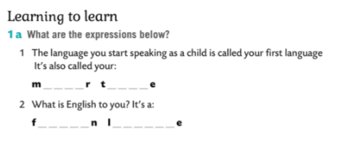
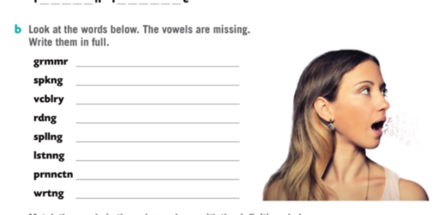
mother tongue
foreign language
grammar
speaking
vocabulary
reading
spelling
listening
pronunciation
writing

Slide 3
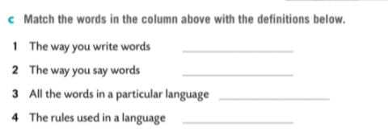

spelling
pronunciation
vocabulary
grammar

Slide 4
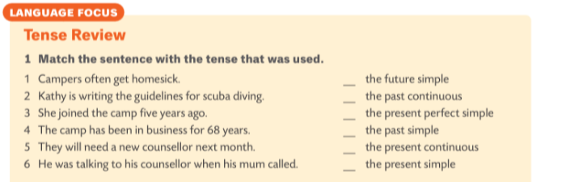
5
6
4
3
2
1

Slide 5
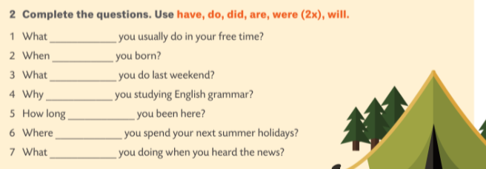



do
were
did
are
have
will
were

